Slide 1
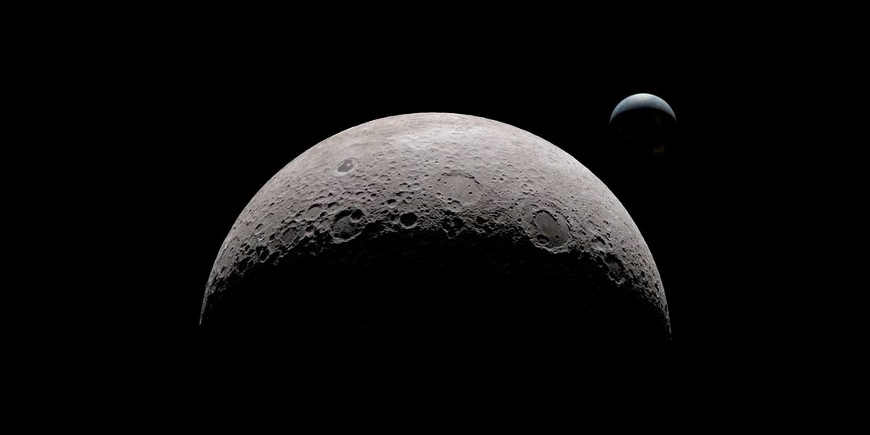
NASA Self-Leveling System
EML 4552
Team 516:
Stephen Brown
James Evans
Dalton LeClair
Jake Seaman
Parker Stensrud

Slide 2












Team Introductions
Stephen Brown
Materials Engineer
James Evans
Design Engineer
Dalton LeClair
Test
Engineer
Jake Seaman
Systems Engineer
Parker Stensrud
Controls Engineer
Jake Seaman

Slide 3




Sponsor and Advisor
Project Sponsor
Rachel McCauley
NASA Marshall Space Flight Center
Faculty Advisor
Dr. Dorr Campbell
FAMU-FSU College of Engineering
Jake Seaman

Slide 4

Project Background
Jake Seaman

Slide 5

Project Scope
The objective of our project is to provide a level working environment for the astronauts aboard the lunar lander.
Jake Seaman

Slide 6






Jake Seaman

Slide 7

Project Goals
Level Within an Hour
Leveling Capabilities up to 12-Degree Slope
Reusability
Supports 14-16 Metric Tons
Jake Seaman

Slide 8


Concept Development
Jake Seaman

Slide 9
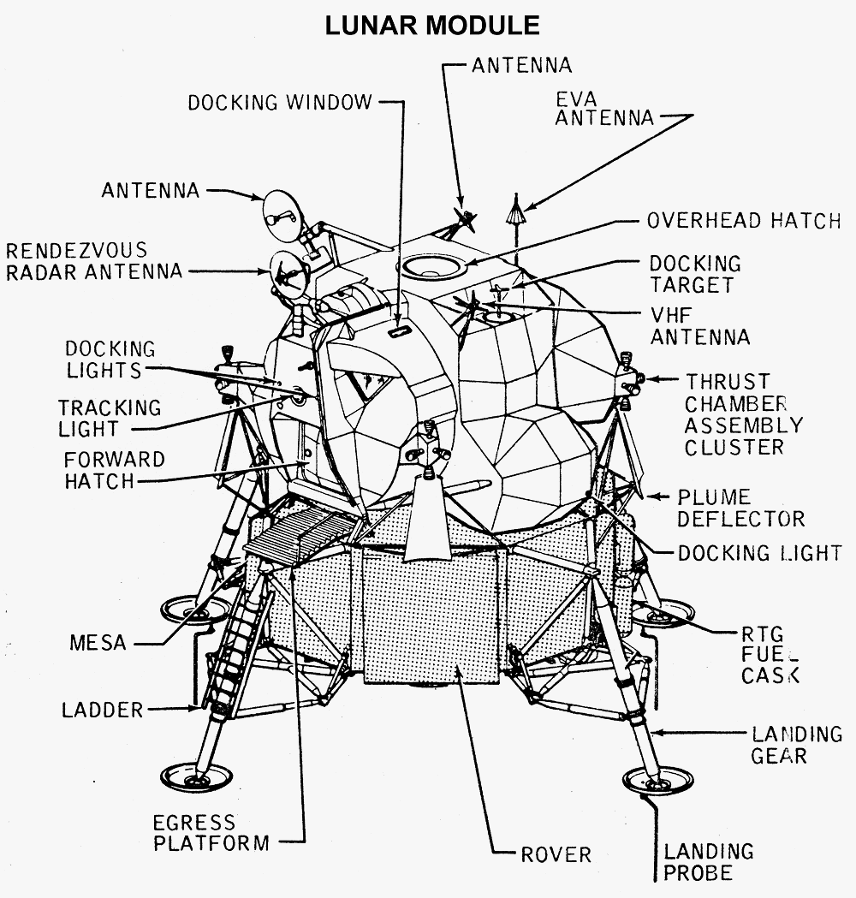
Concept Ideation
Jake Seaman

Slide 10
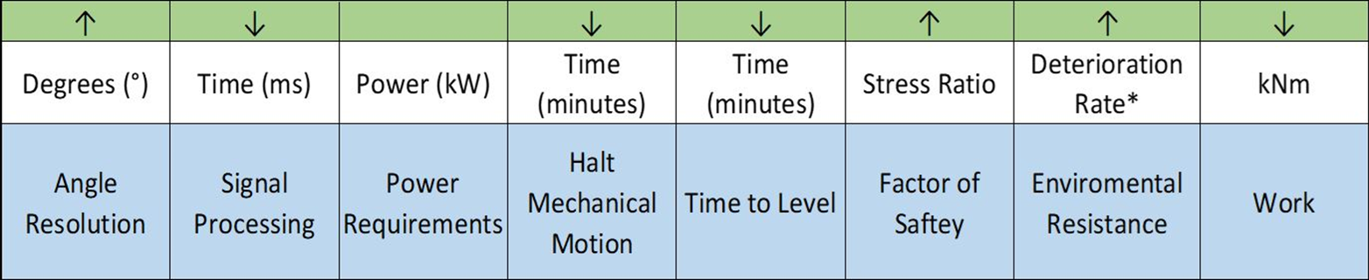

Developing Concepts
Brainstormed 100 concepts
Narrowed concepts down into 5 medium fidelity and 3 high fidelity
Processed medium and high-fidelity concepts
Linear Actuator ranked highest
Jake Seaman

Slide 11
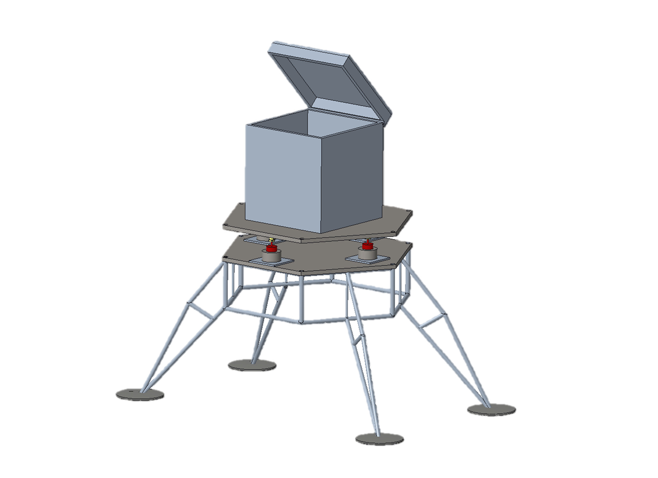
Initial Concept
Jake Seaman

Slide 12


Prototype Breakdown
James Evans

Slide 13
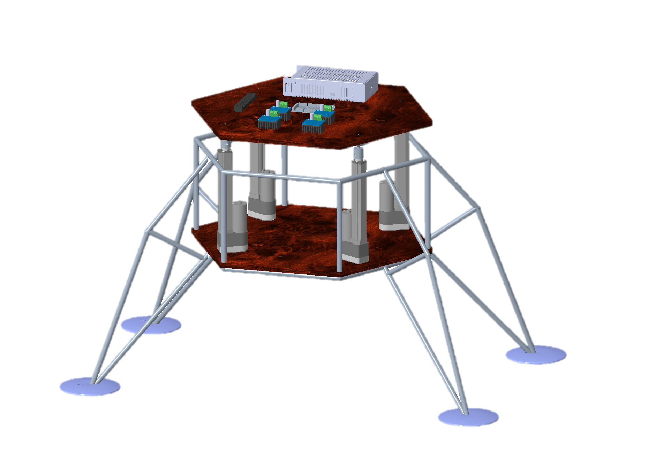
Prototype Critical Numbers
Impact Force: 29.12 lbf
Stress on Actuators: 31.65 lbf/in^2
Moment Experienced: 5.63 lb*in
Stroke Length: 6 in @ 12⁰
Vertical Force: 15 lbf
James Evans

Slide 14
L.V.L.S.
Local Vertical Leveling System
System Logic/Electronics
Actuator Joint
Optical Feedback Electronic Actuators
Prototype Base
James Evans

Slide 15
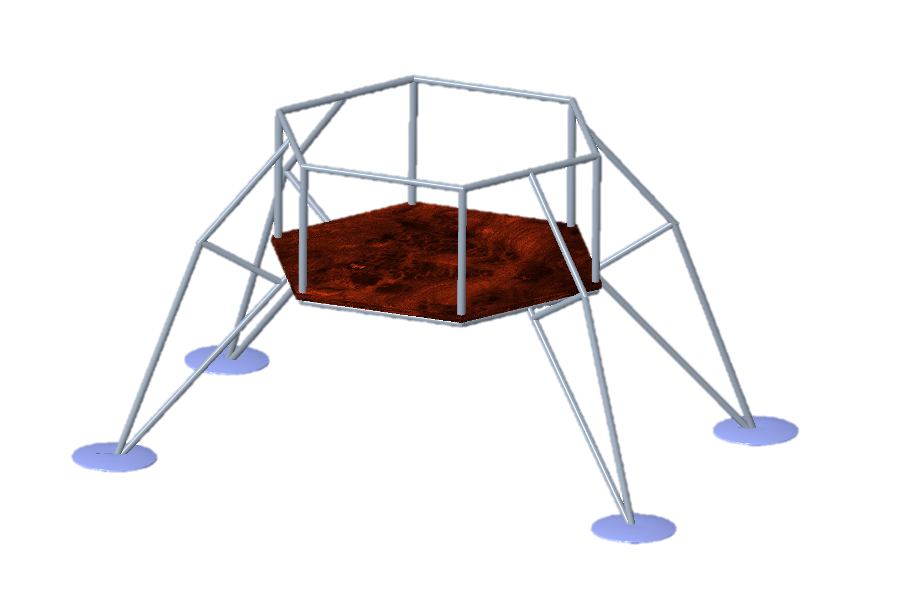
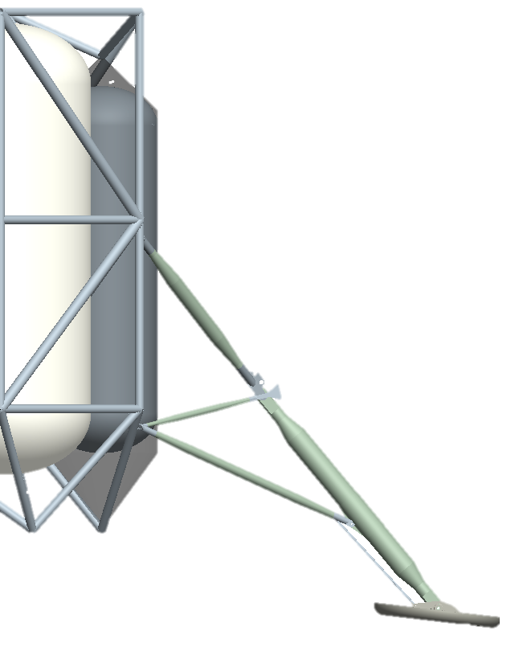
Prototype Base
Landing Gear Concepts designed by Spacecraft Design Team
Support up to 40lbs
Provide stable platform for equipment
James Evans

Slide 16
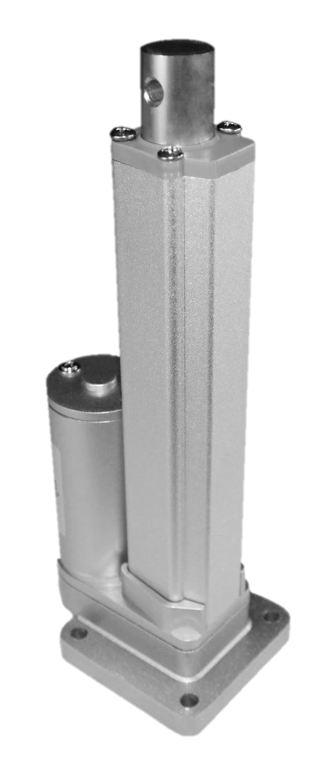
Leveling Component
Four linear actuators placed in an orientation that allows for largest coverage
240 lbs of vertical force
Coupled with optical encoders
Allows for extension and retraction
James Evans

Slide 17
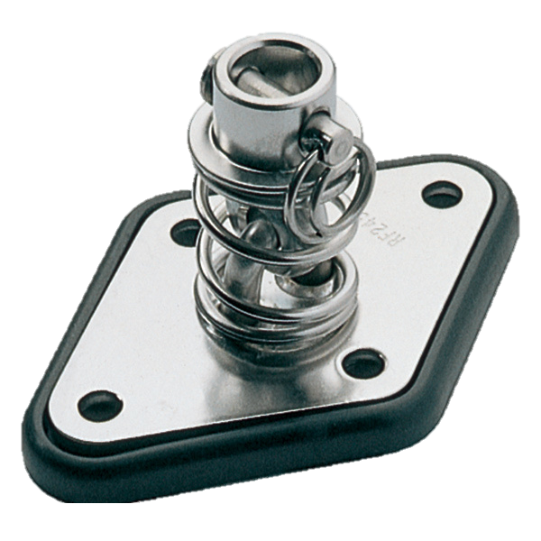
Actuator Joint
Two interlocked hooks prevent dislocation
Spring to create resistance to counter slight tipping on the top platform
Clevis pin connects actuator to joint
James Evans

Slide 18
System Logic
Using Arduino Mega 2560
  Communicates orientation data via IMU
  Iterative adjustments comparing current angle to pre-adjust angle
  Coarse adjustment until within ±5° of level, fine adjustment until ±2°
  Optical encoders ensure each actuator moves correct amount
Parker Stensrud

Slide 19
Leveling Process
Actuators rise 3 inches to its midpoint
IMU takes initial orientation readings
Angle is converted into a linear displacement for the actuators
Opposing actuators will move simultaneously
One axis will level at a time
Parker Stensrud

Slide 20
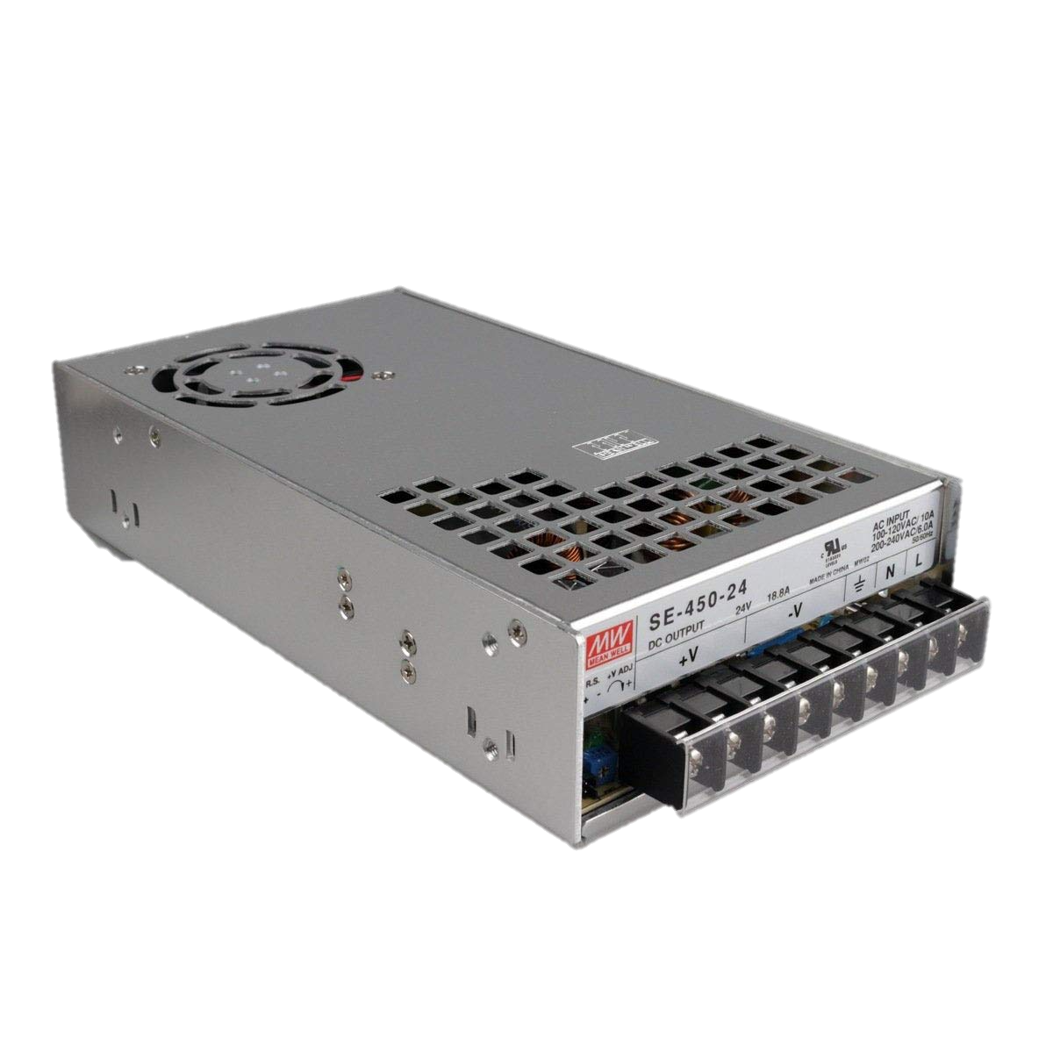
Power Distribution
Mean Well SE-450-12 Power Supply
  Outputs 12V at 37.5A
  Fused at 30A
  4 IBT-2 motor drivers wired in parallel
Parker Stensrud

Slide 21
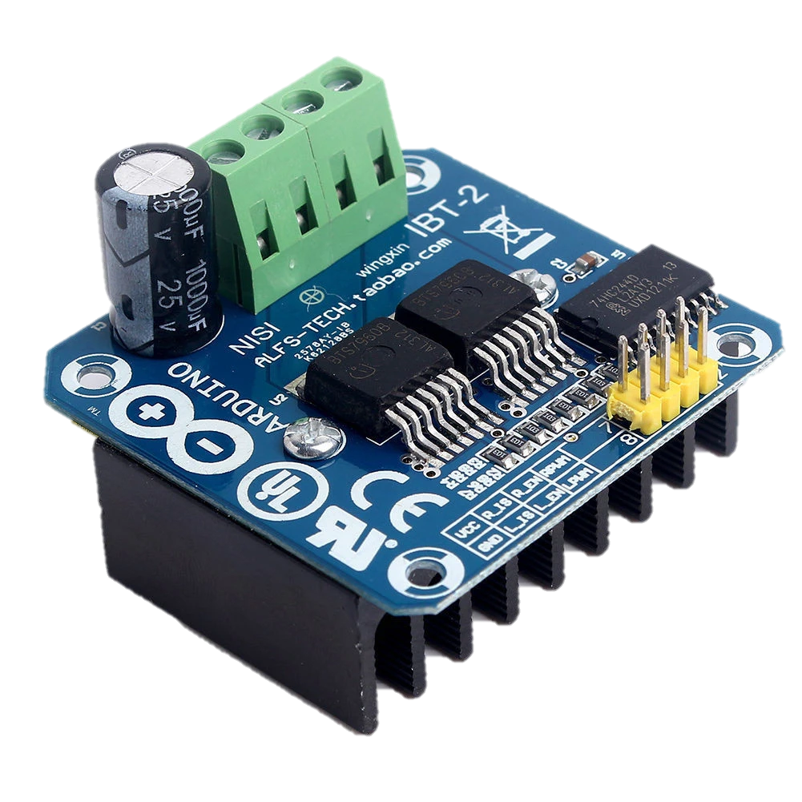
Hardware
IBT-2 Motor Drivers
  Requires 5V for logic, 12V for motor power
  Allows for independent motor control
  Maximum output of 43A
Parker Stensrud

Slide 22
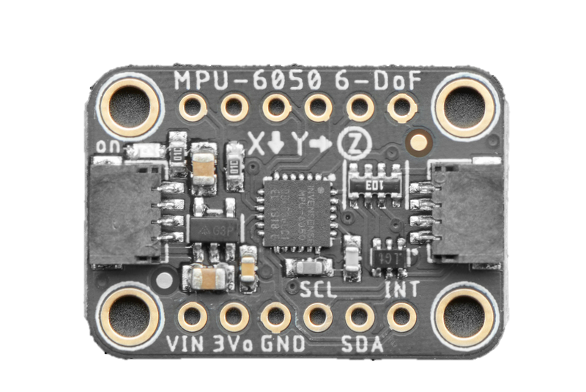
Hardware
MPU-6050 IMU
  Requires 5V input
  Communicates via I2C
  Predefined orientation
  Multiple output formats allows for different logic.
Parker Stensrud

Slide 23
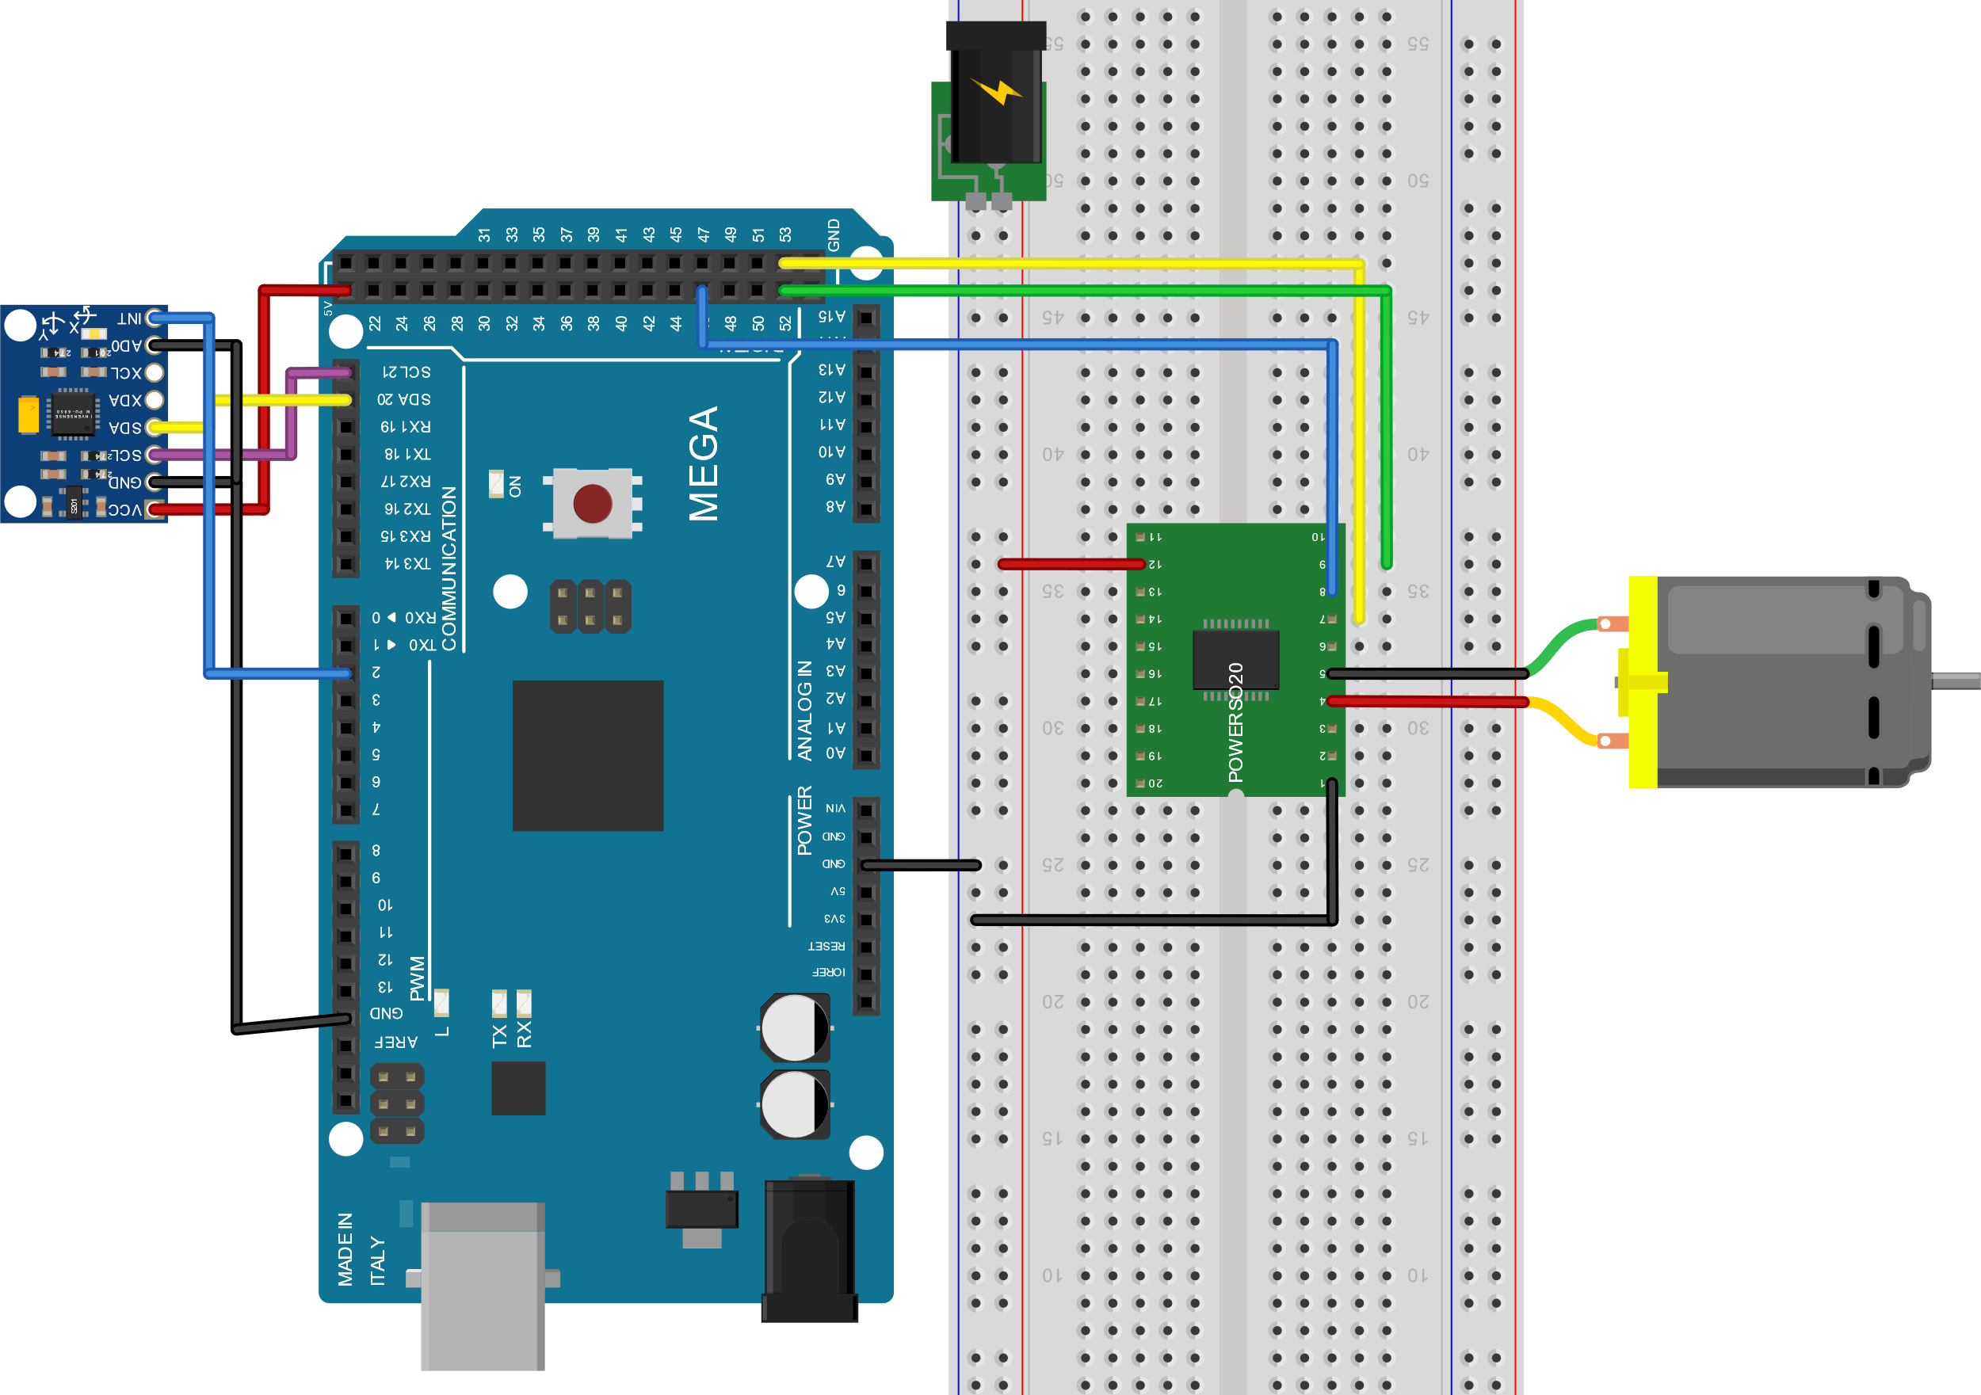
Wiring Schematic
12V 37.5A Power Supply
MPU-6050 IMU
Linear Actuator with Optical Encoder
Arduino Mega 2560
IBT-2 43A Motor Driver
Parker Stensrud

Slide 24
Testing
Dalton LeClair

Slide 25
Testing: Test Objectives
Mission failure: Actuators must be manually adjusted
System must successfully run between tests without intervention
Mission success: Actuators automatically return to starting position
Dalton LeClair

Slide 26
Testing: Test Objectives
Mission failure > 10 minutes
Total system leveling must be complete under time constraint
Mission success < 10 minutes
Dalton LeClair

Slide 27
Testing: Test Objectives
Mission failure > 5 deg
Must successfully level in any orientation
Mission satisfactory < 5 deg
Mission success < 3 deg
Dalton LeClair

Slide 28


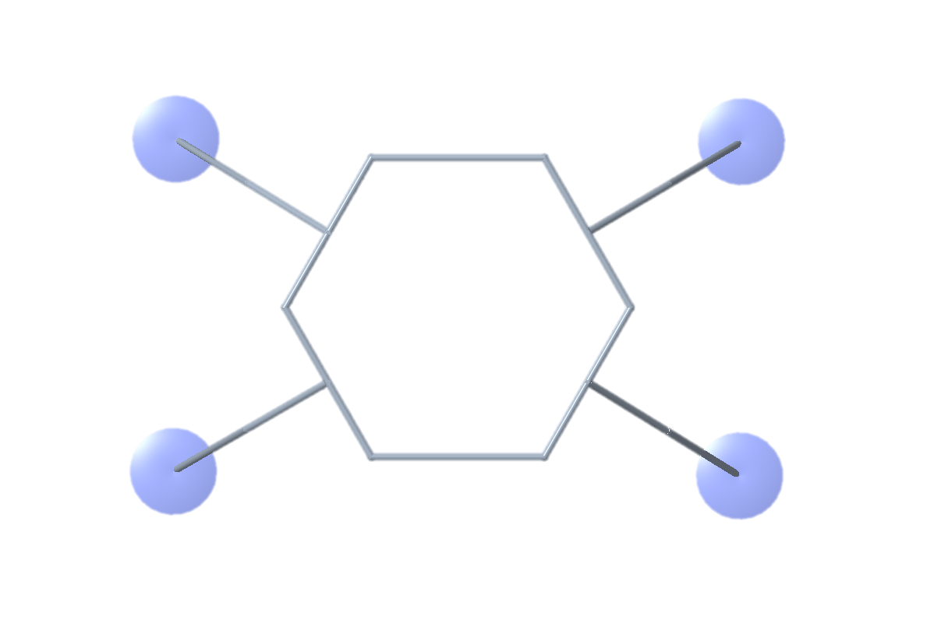
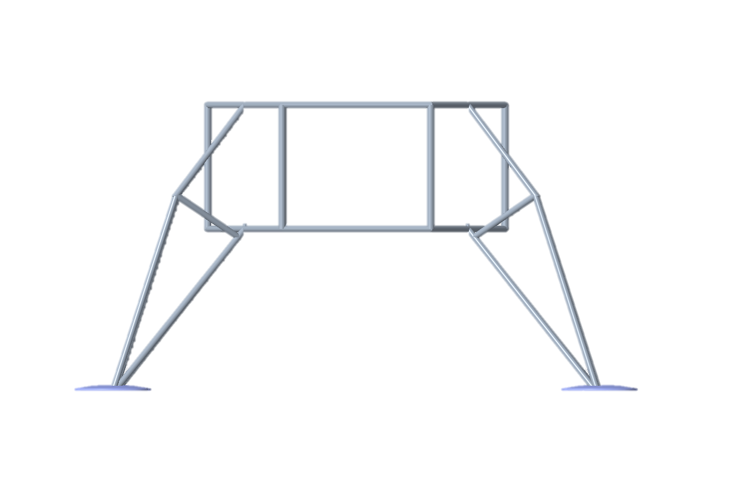
Testing: Methods
53 in x 53 in platform
Use 0.87-inch-thick boards to increment 1 degree
Test any orientation
Dalton LeClair

Slide 29
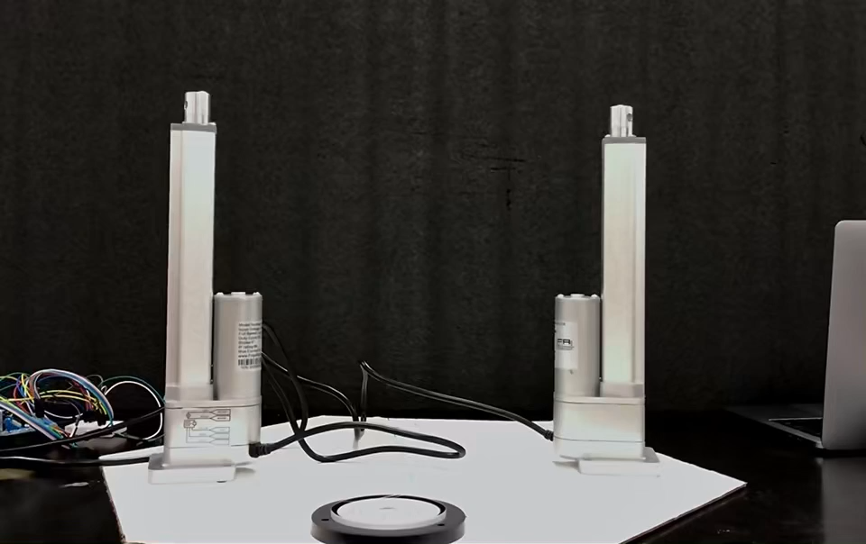
Testing
Dalton LeClair

Slide 30
Preparing For Space
Linear Actuators
Actuator Joint
Electronics
Stephen Brown

Slide 31
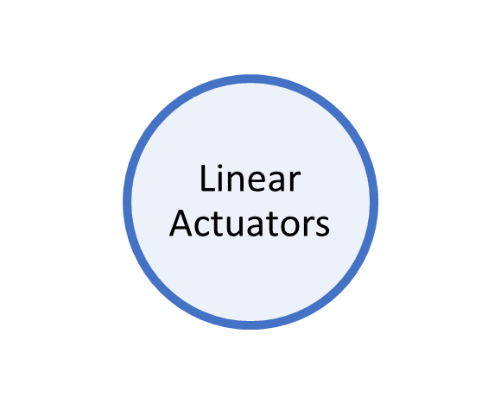
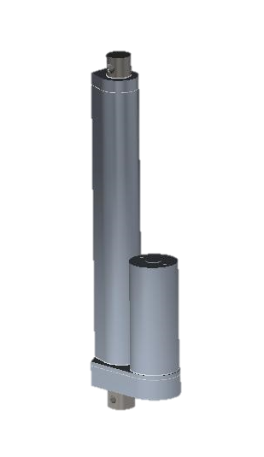
Capabilities
301 Annealed Stainless Steel
30 inch Stroke length
4000 Ibs Dynamic force
Withstand 4040 lbf of impact force
2295 Aluminum Alloy
Stephen Brown

Slide 32
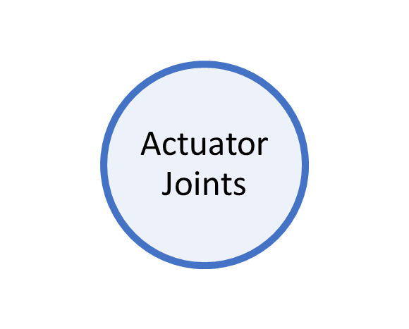
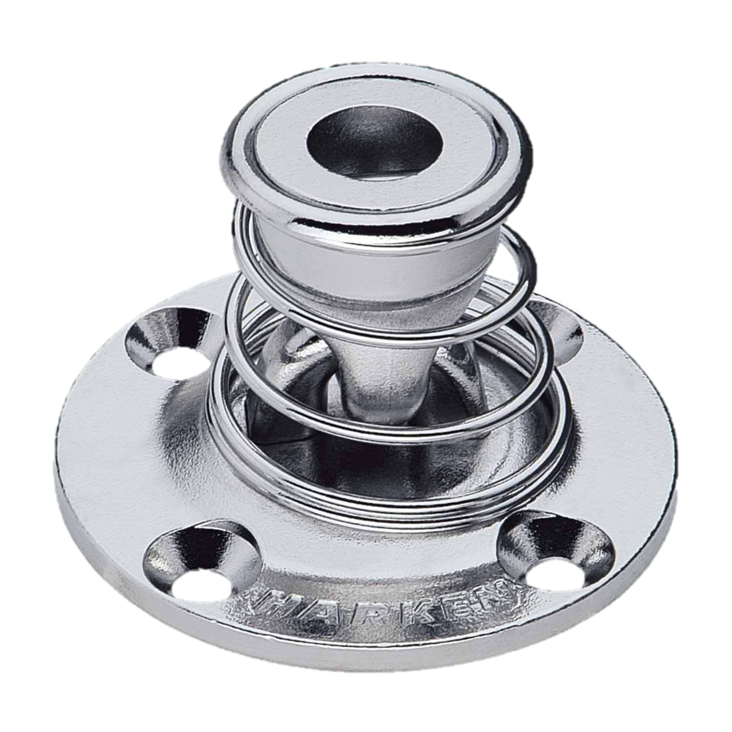
Spring Specs
3,000 lbs/inch Spring Rate
Inside diameter of 2 inches
316 Stainless Steel Spring
301 Stainless Steel
Stephen Brown

Slide 33
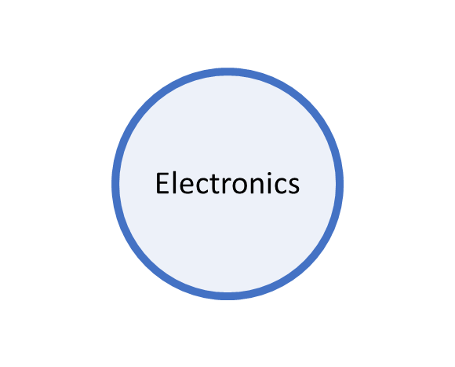
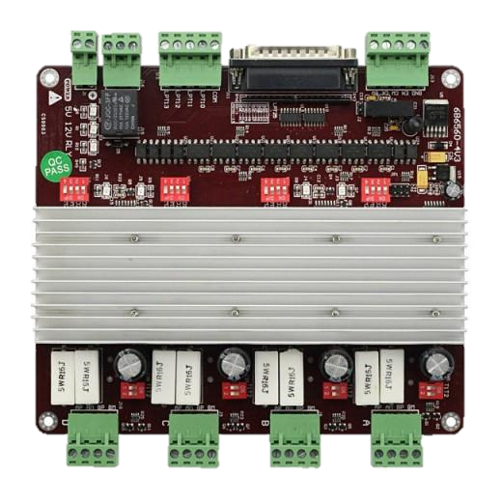
Benefits
Reduce excess hardware and wires
Save valuable space
Faster response time
Centralized Power Distribution
4 outputs
Stephen Brown

Slide 34


Future Work
Assemble and test prototype
Analyze test results
  Make adjustments to optimize design
Explore integrating system into legs
Test until prototype failure
Stephen Brown

Slide 35
Lessons Learned
Don’t be afraid to question a design if you believe there is a better approach
Communication is essential to working in a team
Using a systems engineering approach ensures all necessary work is accomplished
Mistakes will be made, respond with determination
Stephen Brown

Slide 36












NASA Self-Leveling System
EML 4551
Connect with us!
Team 516:
Stephen Brown
James Evans
Dalton LeClair
Jake Seaman
Parker Stensrud

Slide 37
Reference
Admin. (2017, July 27). A guide to aluminum use in the aerospace industry. Retrieved March 19, 2021, from https://continentalsteel.com/blog/aerospace-aluminum-guide/
Premium linear actuators. (n.d.). Retrieved February 13, 2021, from https://www.firgelliauto.com/products/premium-linear-actuators
Reichelt elektronik GmbH & Co. KG Internet Team (webmaster@reichelt.de). (n.d.). ARDUINO MEGA - Arduino Mega 2560, ATmega1280, USB. Retrieved January 11, 2021, from https://www.reichelt.com/de/en/arduino-mega-2560-atmega1280-usb-arduino-mega-p119696.html?GROUPID=6667&&r=1
S. (n.d.). Landing Gear Concepts & Metrics Review. NASA PowerPoint.
Fuchs, Y. (2007, June 28). Lunar Lander Landing System Dynamics Analysis, Testing, and Certification. NASA PowerPoint.
Project apollo diagrams. (n.d.). Retrieved February 13, 2021, from https://history.nasa.gov/diagrams/apollo.html
NASA’s Lunar Exploration Program Overview. (2020, September). Retrieved January 10, 2021, from https://www.nasa.gov/sites/default/files/atoms/files/artemis_plan-20200921.pdf

Slide 38
Budget
Parker Stensrud

Slide 39
Prototype Scaling
Full Size Lander
Dimensions/footprint | 31 ft x 20 ft
Weight | 14-16 tons
Time to level | 1 hour
Scaled Prototype
Dimensions/footprint | 50 in x 31 in
Weight | 60 lbs
Time to level | 10 minutes
James Evans

Slide 40



Team Introductions
Stephen Brown
Materials Engineer
James Evans
Design Engineer
Dalton LeClair
Test
Engineer
Jake Seaman
Systems Engineer
Parker Stensrud
Controls Engineer
James Evans

Slide 41
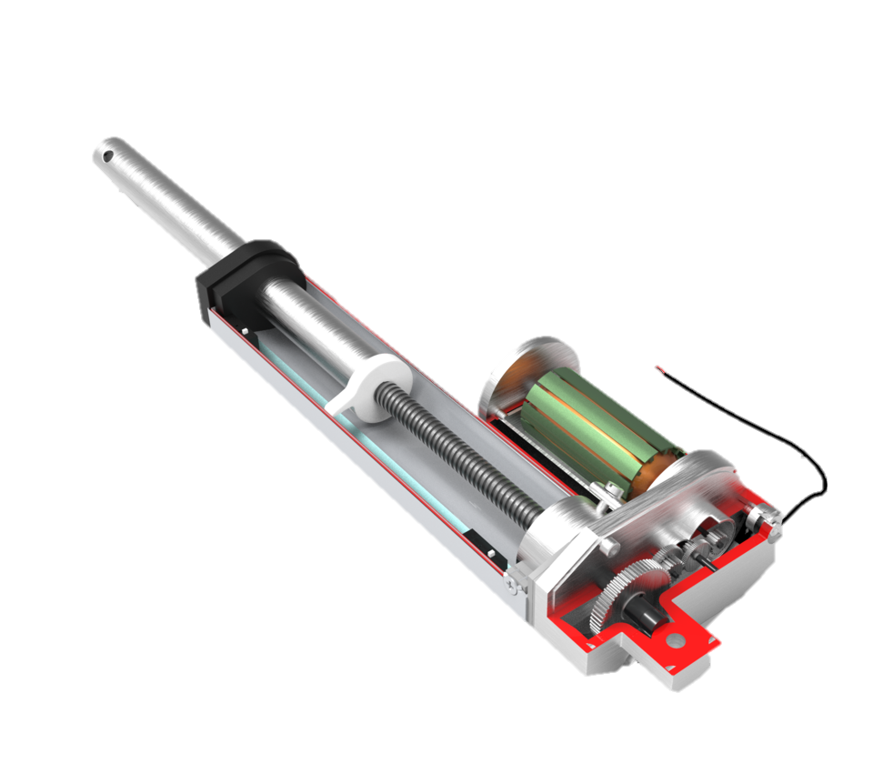
Concept Revision
Worm gear driven linear actuator
Linear actuators will be recessed into the lander base to minimize the distance between legs and capsule.
Benefits of this decision
Dalton LeClair

Slide 42
Schedule
Not Started
In Progress
Complete
Current Stage
Parker Stensrud

Slide 43
Prototype Critical Numbers
Impact Force: 129.55 N
Stress on Actuators: 21.82 N/cm^2
Moment Experienced: 63.58 N*cm
Stroke Length: 6 in @ 12⁰
Vertical Force: 66.75 N
James Evans

Slide 44
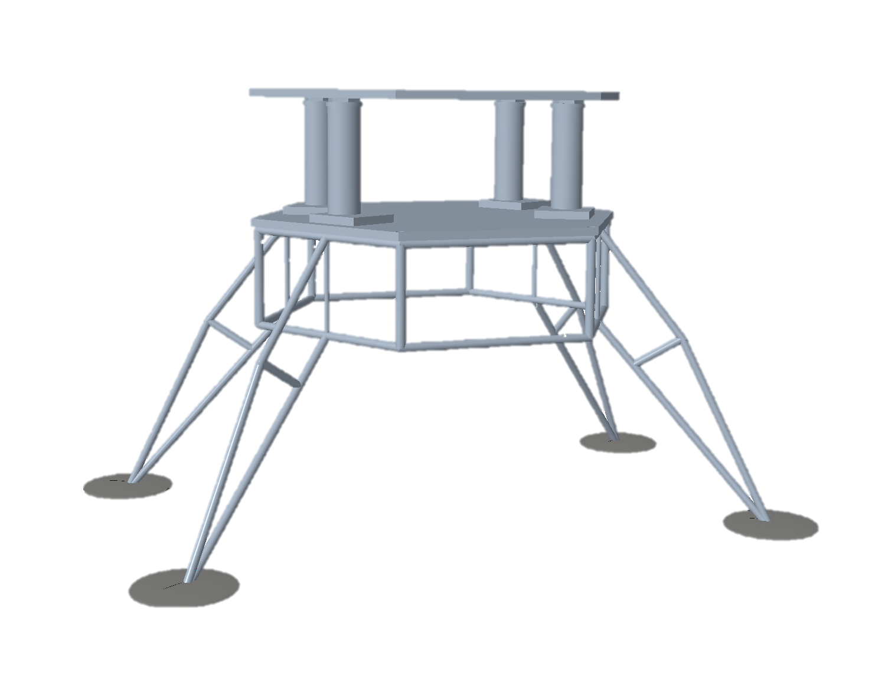
Bottle Jack Prototype
Flaws
Many possible failure points
Too much distance between the leg base and the lander cabin
  Potential for tipping
Dalton LeClair

Slide 45
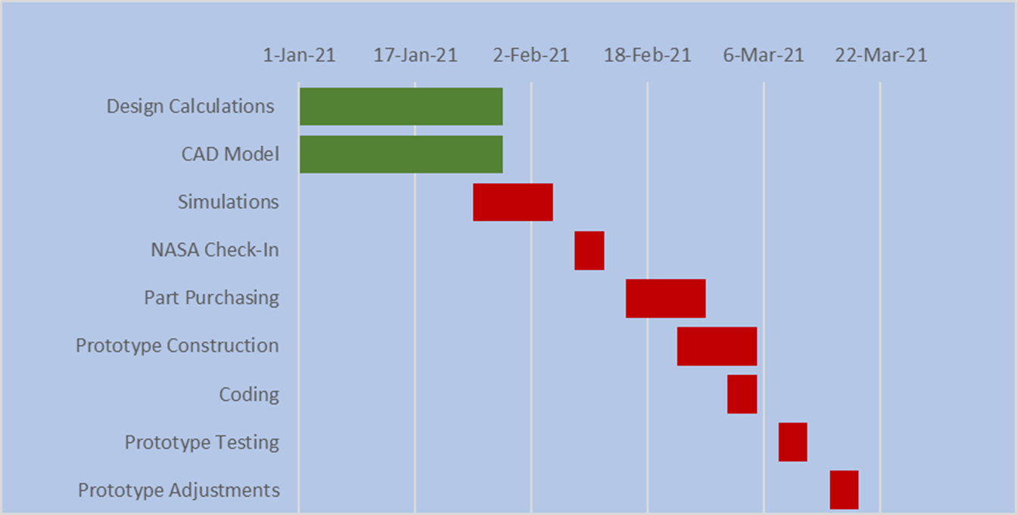


Future Work
Dalton LeClair

Slide 46
Schedule
In Progress
Not Started
Identified Risk
Current Stage
Jake Seaman

Slide 47
Concept Validation
James Evans

Slide 48
Concept Critical Numbers
Impact Force: 17.97 kN
Stress on Actuators (θ = 12⁰): 31.4 kN/m^2
Moment Experienced: 52.9 kN*m
Stroke Length: 0.762 m @ 12⁰
Vertical Force: 25.2 kN
James Evans

Slide 49
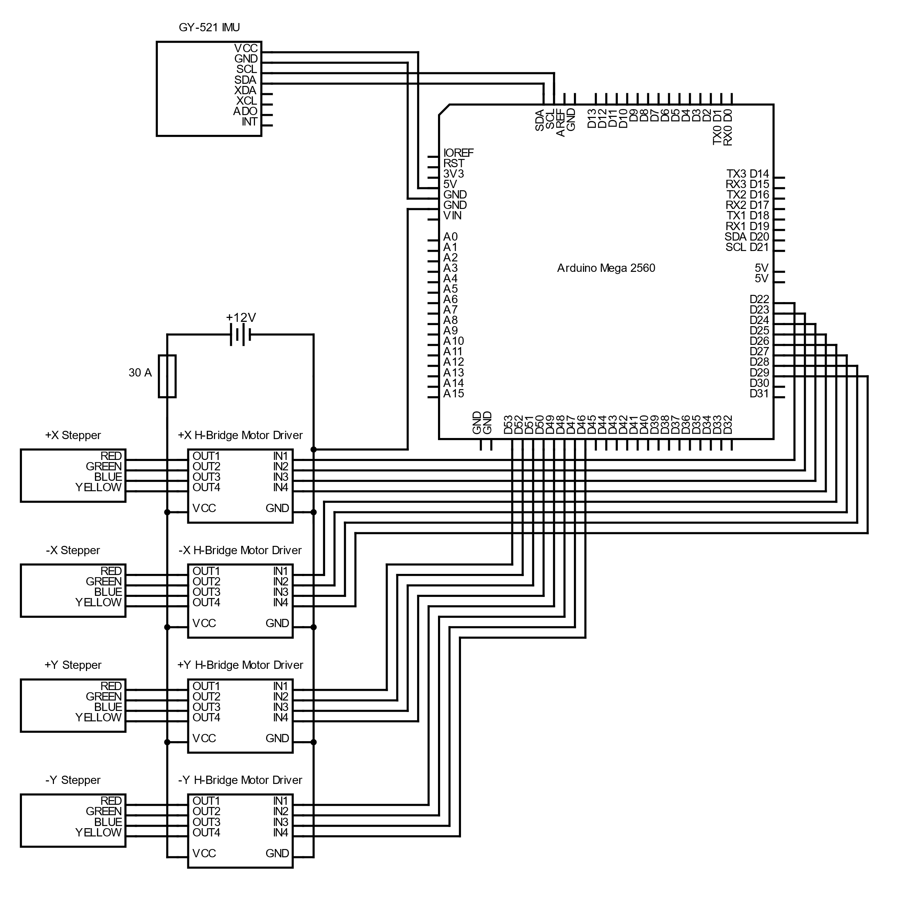

Slide 50
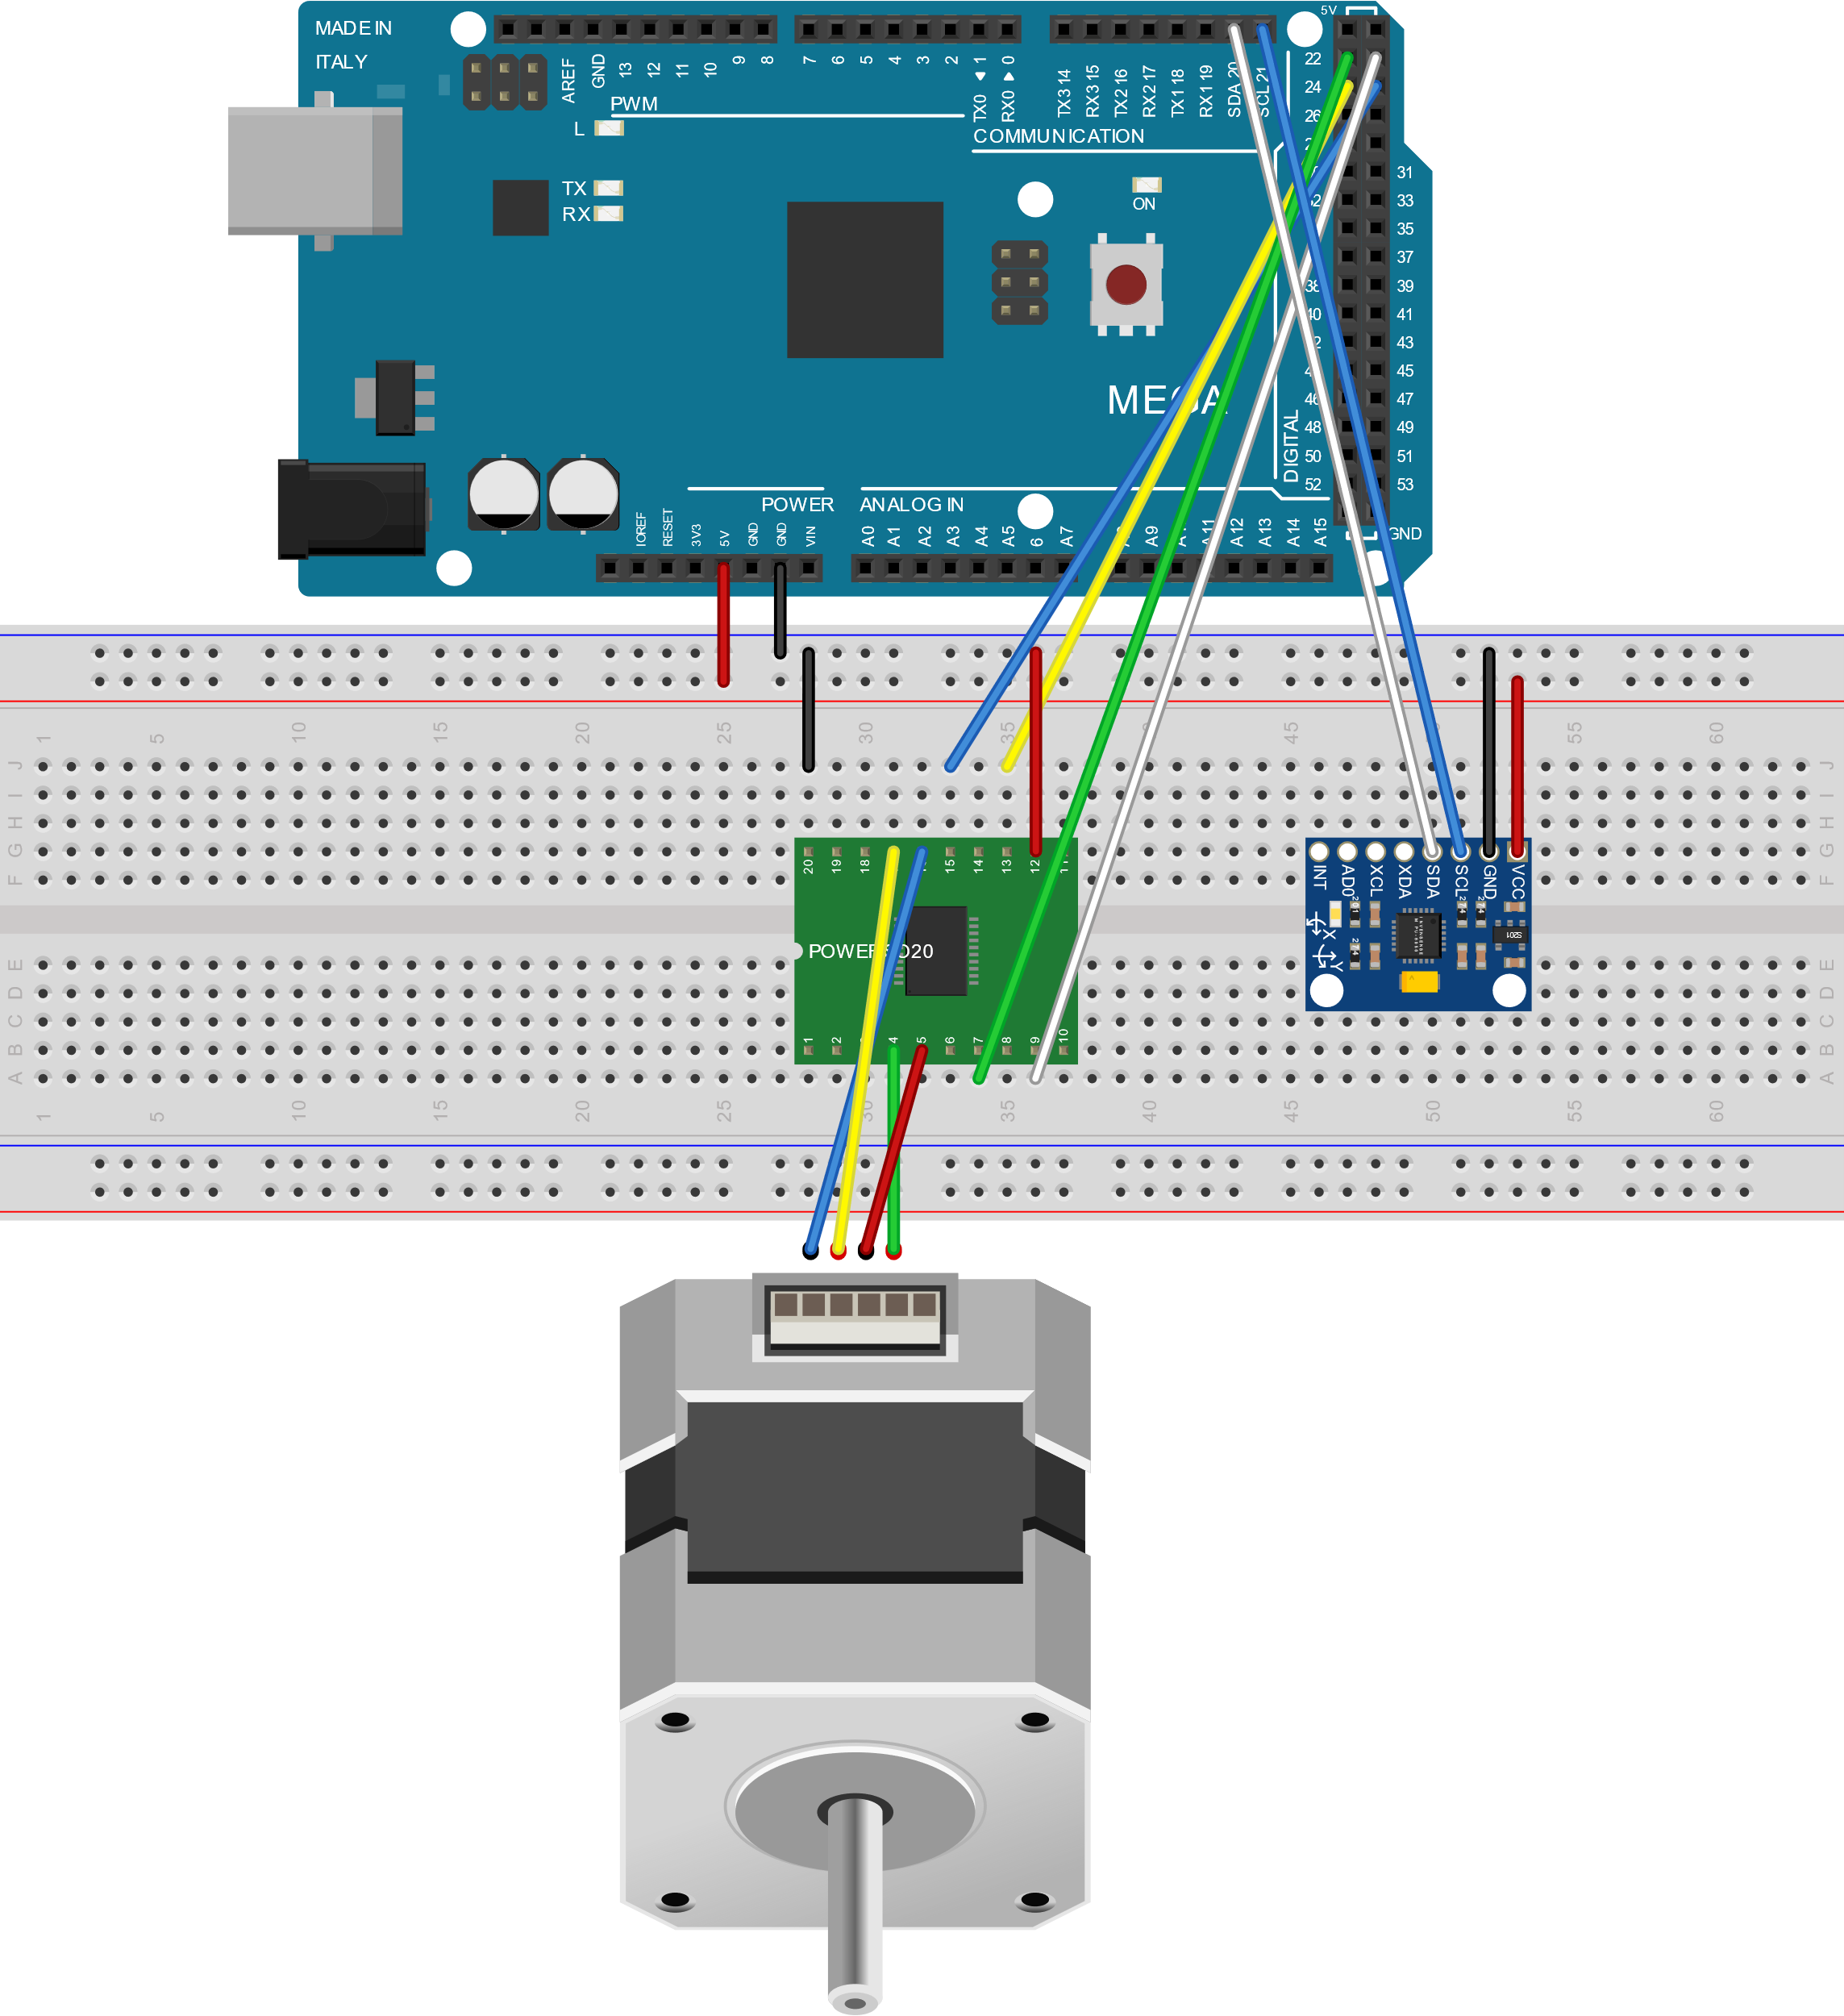
Wiring Schematic
Controlled by Arduino Mega 2560
  4 L298 Motor Drivers
  4 NEMA17 Steppers
  GY-521 IMU for input
  12V 35Ah battery in parallel used to power the steppers
Dalton LeClair

Slide 51

Environmental Challenges
Sand-blasting due to regolith
Coefficient of thermal expansion
Cold Welding
Radiation
Dalton LeClair

Slide 52
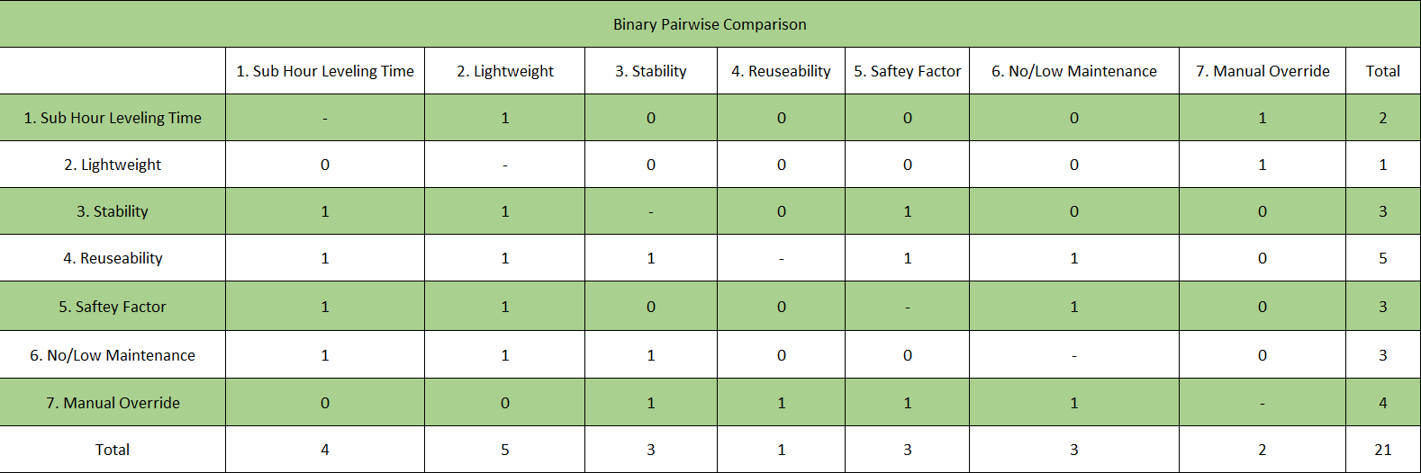
Binary Pairwise Comparison
Parker Stensrud
Notes:
customer requirements on both axis.

Slide 53
Binary Pairwise Comparison
Parker Stensrud
Notes:
These are customer requirements . Used to get importance weight factor

Slide 54
Background/scope
Goals
Original design
Secondary design with bottle jacks
Explain challenges/reasons for changing
Introduce new idea&cad and explain individual parts like DR4
Small things we're thinking of improving: bubble levels, wire pathway thing etc
Schedule & expected challenges
Questions: include our QR codes this time?
Use our acronym L.V.L.S.

Slide 55
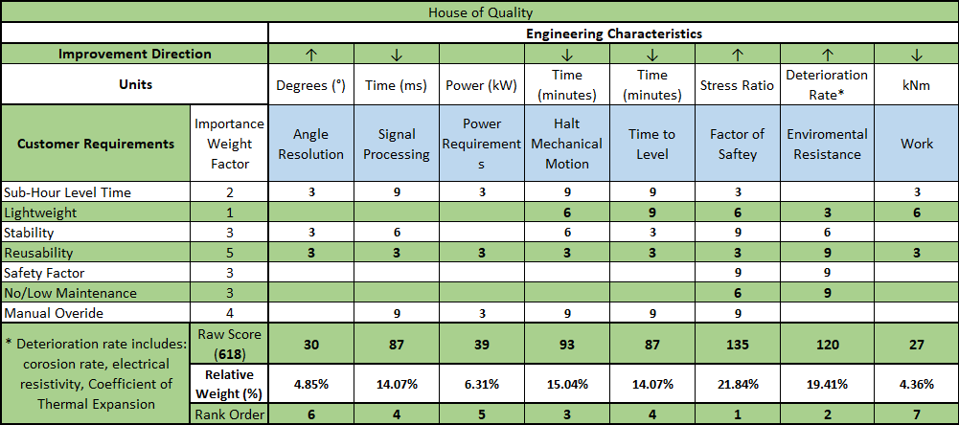
House of Quality
Parker Stensrud

Slide 56
House of Quality
Parker Stensrud

Slide 57
House of Quality
Parker Stensrud
Notes:
engineering characteristics are derived from the functional decomposition

Slide 58
House of Quality
Parker Stensrud

Slide 59
Concepts
Datum(slider)
Rack and pinion
Secondary landing gear
Bottle Jack
Gas System
Telescopic legs
Spring System
Tripod
James Evans

Slide 60
Concepts
Datum(Tripod)
Spring System
Rack and pinion
Bottle Jack
Gas System
James Evans

Slide 61
Final Three Concepts
Spring System
Bottle Jack
Gas System
James Evans

Slide 62
Analytical Hierarchy Process
James Evans
19

Slide 63

Leveling Functions
Sense
Power
Lander
Motion
Dalton LeClair

Slide 64
Concept Generation
Dalton LeClair
Notes:
Remember to say that all the concepts get information from the onboard IMU during the presentation

Slide 65

Medium Fidelity
Three-Legged Tripod
  Whole leg design
  Integrated into the landing gear
Slider System
XY translation of the lander cabin to move the center of mass until level
Second Landing Gear
Compact until deployed
Multiple arms to lift the lander until level
Gas Release
Piston Cylinder Assembly
Compressed gas in cylinder is released to level
Rack and Pinion
Allow to move upward and downward
Can be fine-tuned
Dalton LeClair

Slide 66
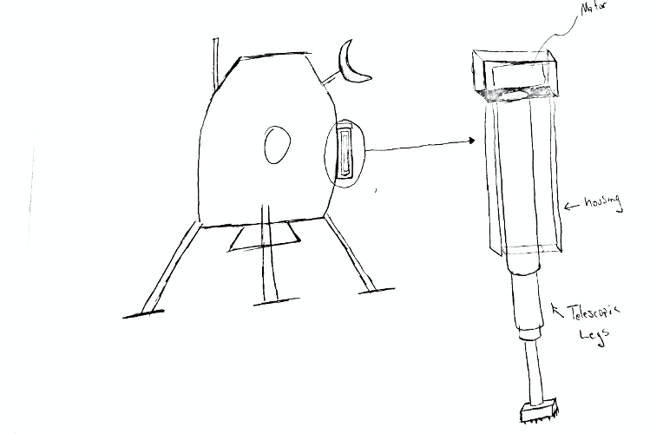
High Fidelity
Telescopic Legs
  Secondary legs not used for landing
  Four (4) housings containing retracted legs and motor to extend them
  Housing will have brush like bottom to dust off legs upon retraction
Parker Stensrud

Slide 67
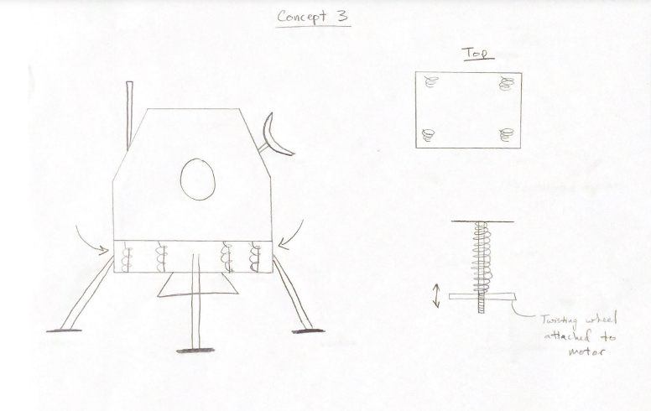
High Fidelity
Spring System
  Begin fully extended
  Springs will be tightened via motors and lowered until level (operates like 3D printer bed)
  Mechanism will be isolated from the elements
Parker Stensrud

Slide 68
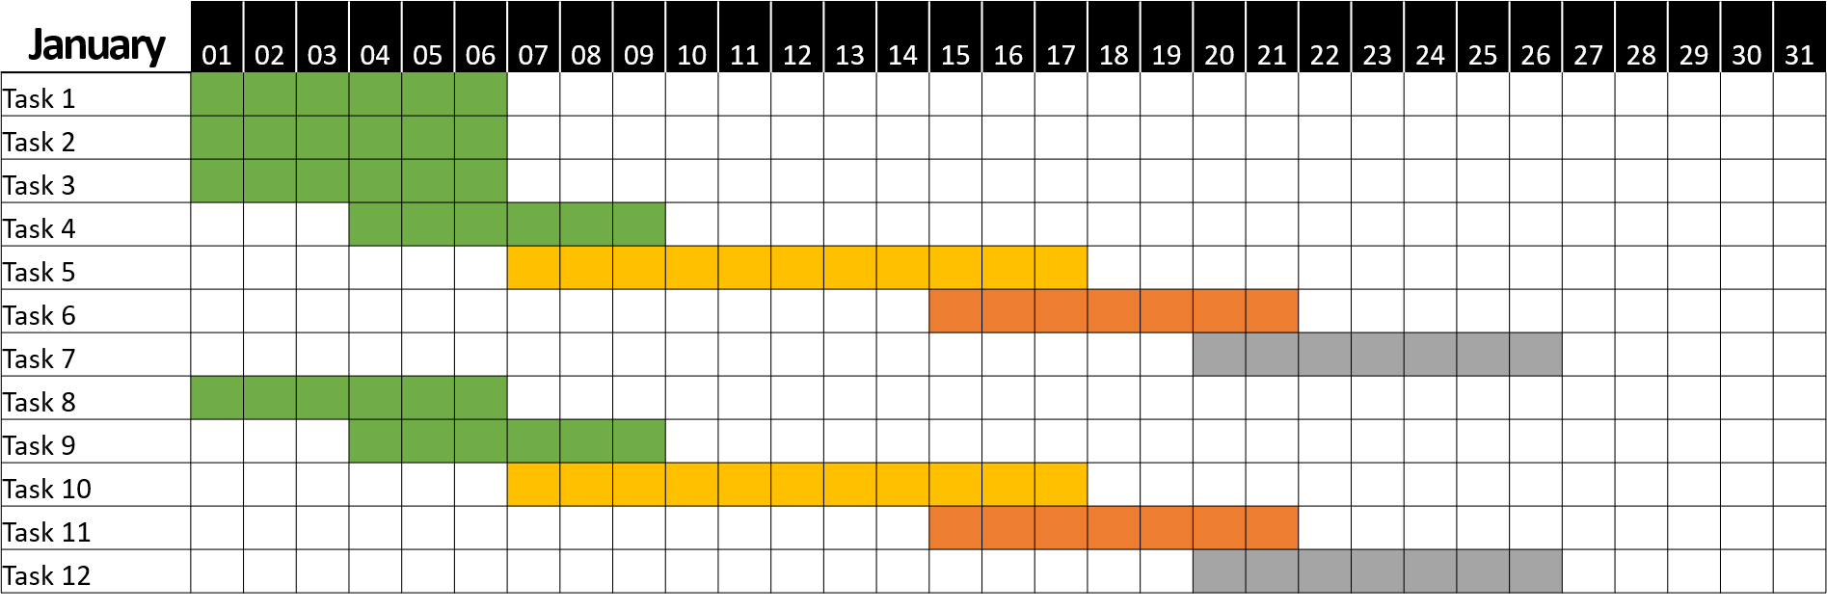
Future Work
January Daily Chart
Milestone 1
Milestone 2
⬧
X Days
⬧
Complete
Identified Risk
Summary: The quick brown fox jumps over the lazy dog. The quick brown fox jumps over the lazy dog. The quick brown fox jumps over the lazy dog. The quick brown fox jumps over the lazy dog. The quick brown fox jumps over the lazy dog.
In Progress
Not Started

Slide 69
Team Introductions
Stephen Brown
Materials Engineer
James Evans
Design Engineer
Dalton LeClair
Test
Engineer
Jake Seaman
Systems Engineer
Parker Stensrud
Controls Engineer
James Evans

